Slide 1
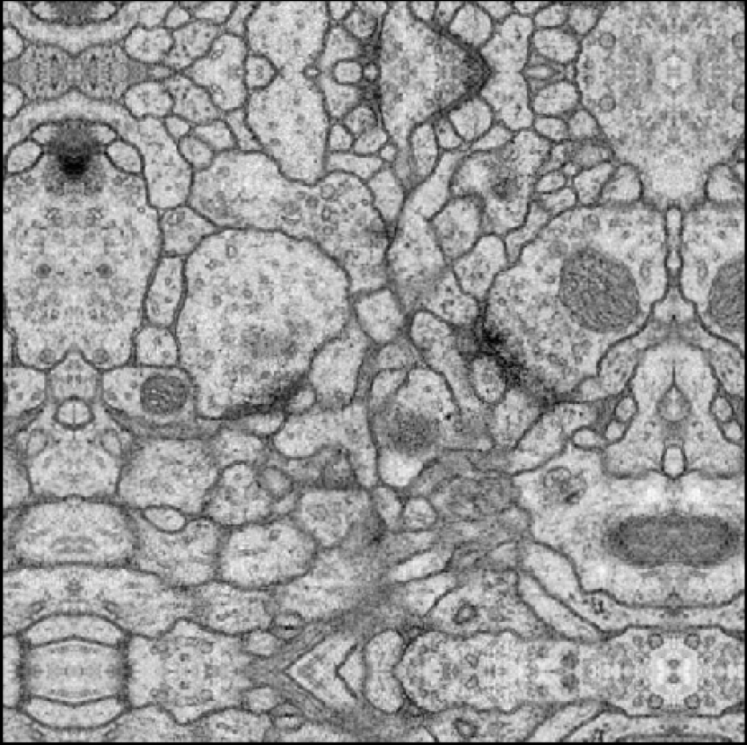
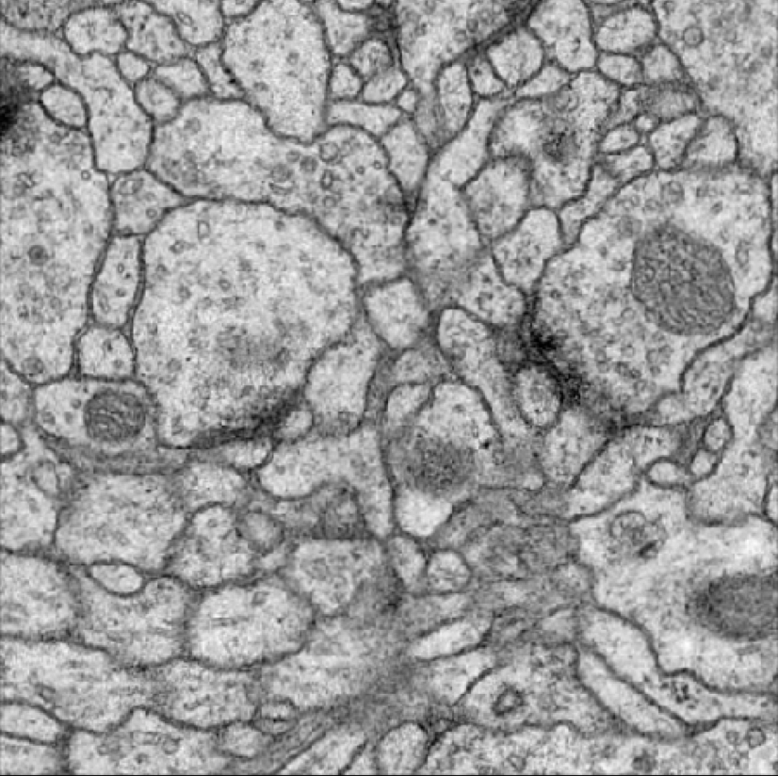
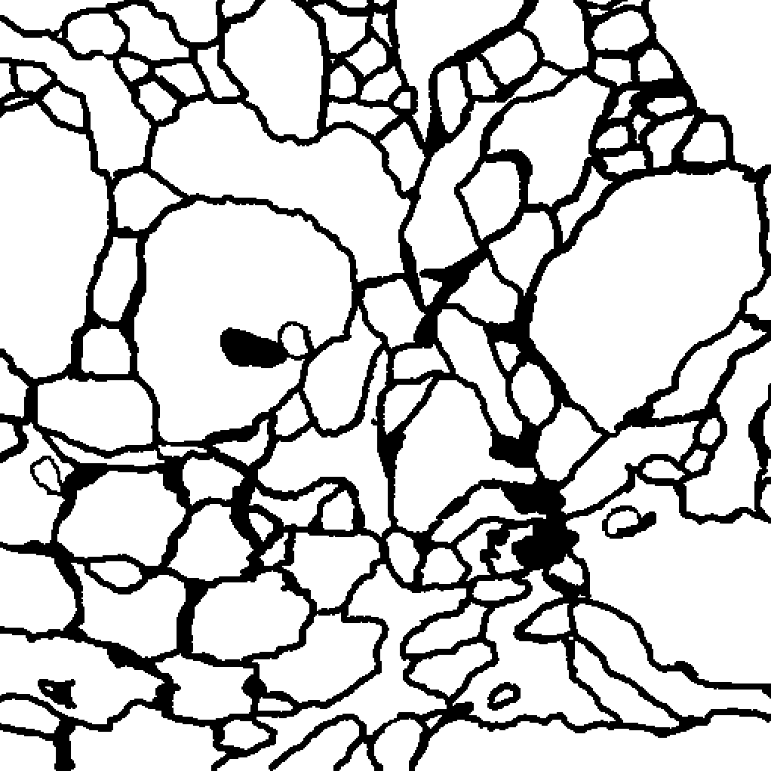
Mirrored input image
Input image
Label image

Slide 2
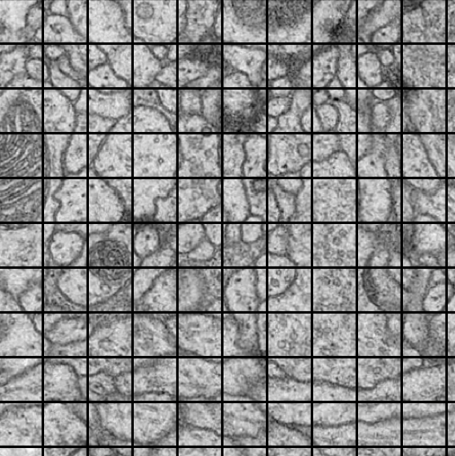
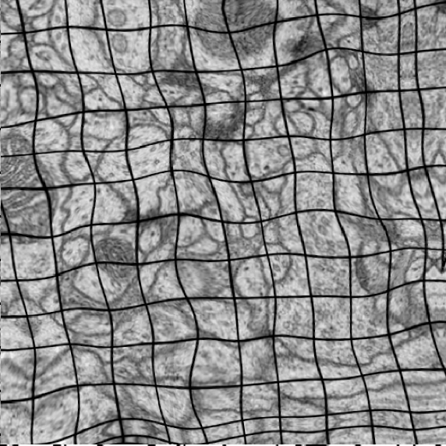
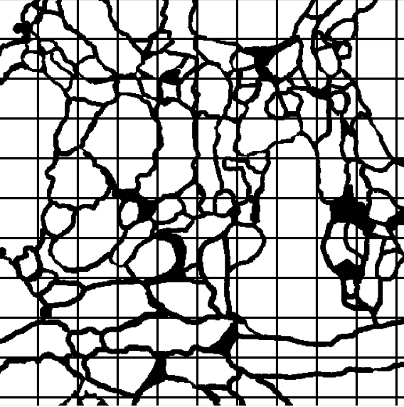
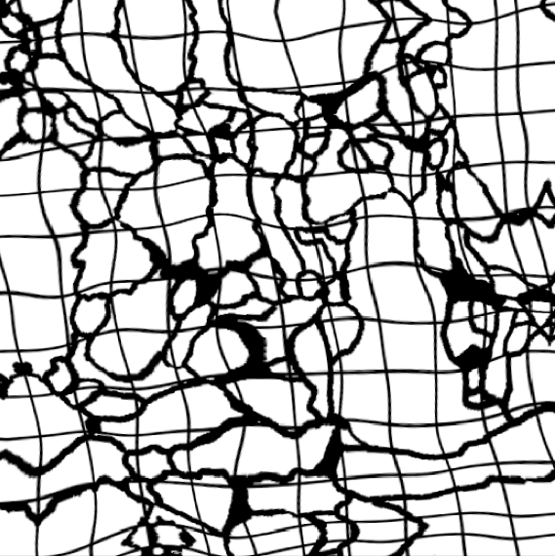

Slide 3
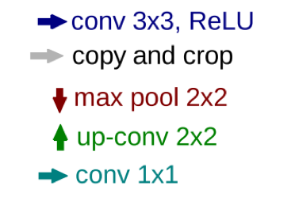




















1
64
64
128
64
64
1
Input
image
Output
segmentation
map
512 x 512
512 x 512
512 x 512
634 x 634
512 x 512
636 x 636
632 x 632
37K
143K
128
128
512
128
$${316}^{2}$$
$${314}^{2}$$
$${256}^{2}$$
$${312}^{2}$$
$${256}^{2}$$
$${256}^{2}$$
221K
508K
256
256
512
256
$${156}^{2}$$
$${152}^{2}$$
$${128}^{2}$$
2.29M
885K
$${154}^{2}$$
$${128}^{2}$$
$${128}^{2}$$
512
512
1024
512
Number of weights in each block
$${76}^{2}$$
$${72}^{2}$$
3.54M
$${74}^{2}$$
$${64}^{2}$$
$${64}^{2}$$
$${64}^{2}$$
9.17M
1024
14.16M
$${36}^{2}$$
$${34}^{2}$$
$${32}^{2}$$

Slide 4
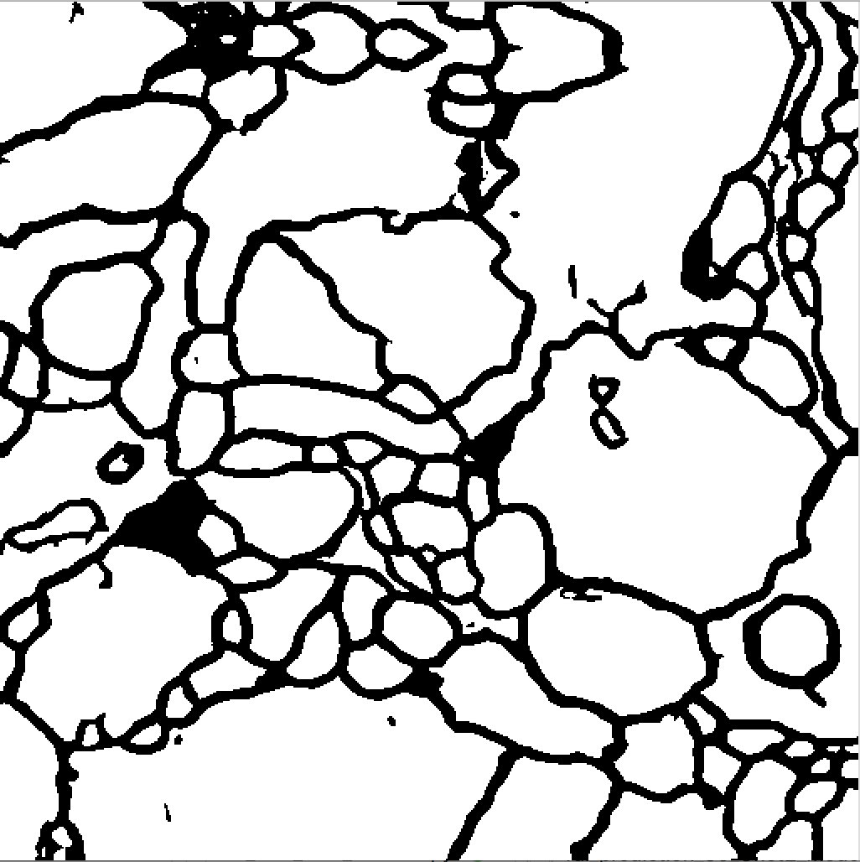
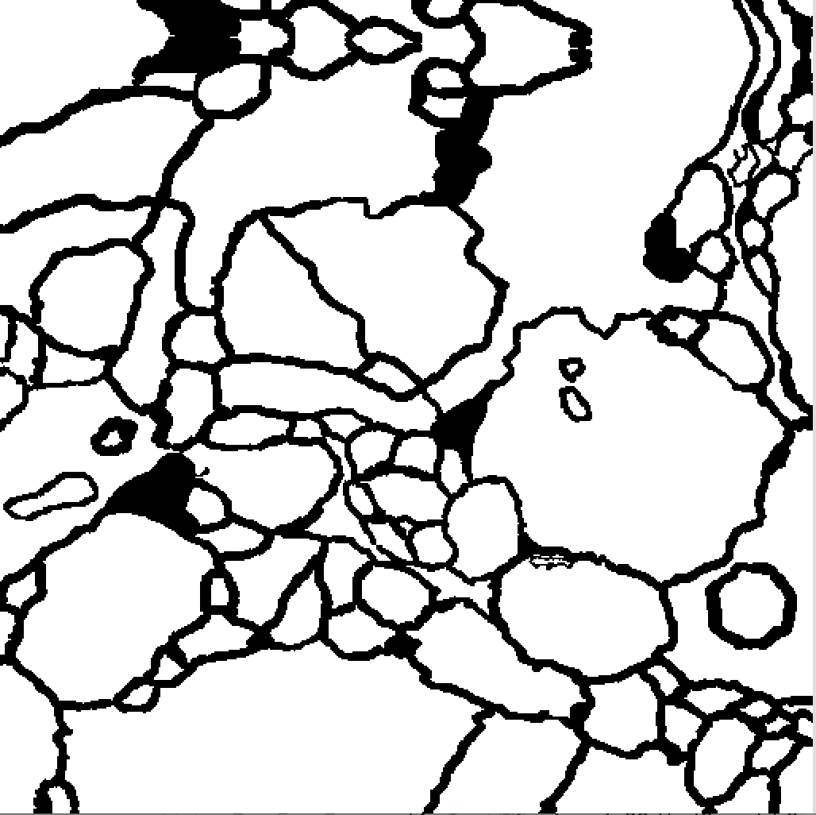
Input image
Prediction
Label image

Slide 5
